Slide 1
AuLA 23
Modelação Ecológica
19 Dezembro 2018 – 14:00-17:00 – sala 2.3.37
Tiago A. Marques

Slide 2
Today’s Menu
14:00-16:00 – Work presentations
Modelos Estacionários
Modelos Dinâmicos
Modelos com Base no Indivíduo
Modelos de Lógica Difusa
16:00 - Concluding remarks to “Modelação Ecológica”

Slide 3
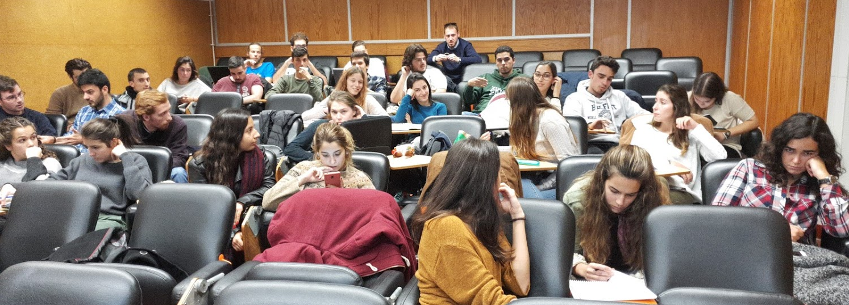
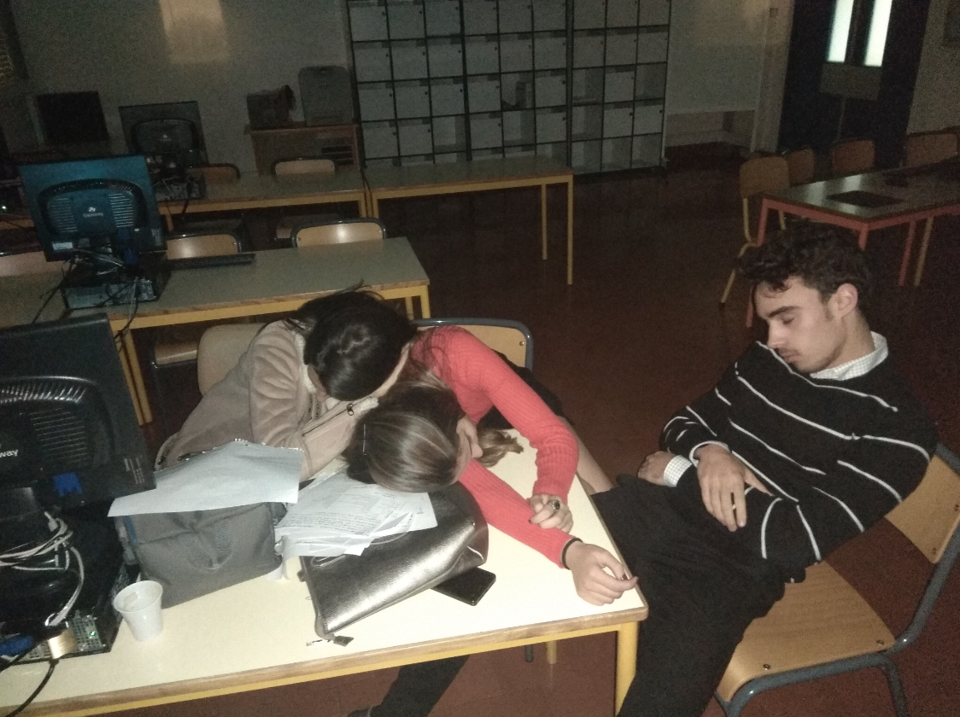
PRESENTATIONS
Students… the floor is yours !

Slide 4
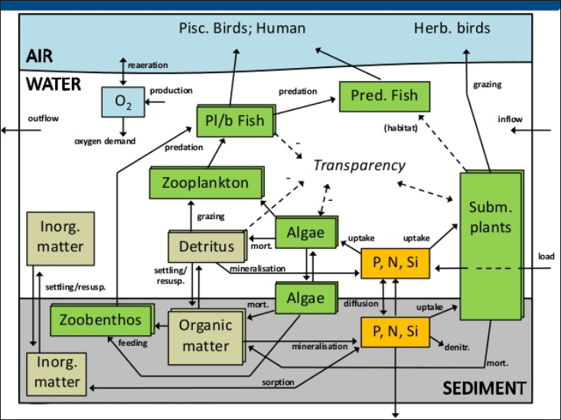
Concluding remarks to “Modelação Ecológica”

Slide 5
Modelos
de base estatística
Modelos de estado estacionário
Modelos dinâmicos
Caracterizam os estados de interesse
Modelos com base no indivíduo
Modelos de lógica difusa

Slide 6
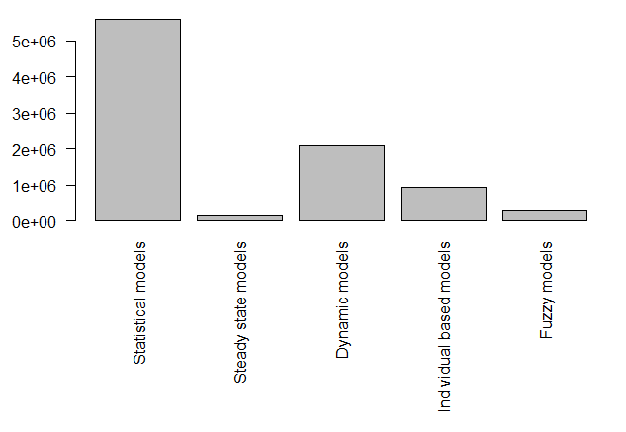
Google search hits
Notes:
par(mfrow=c(1,1),mar=c(11,4,1,1))
barplot(c(5600000,158000,2090000,165000+763000,320000), names.arg=c("Statistical models","Steady state models","Dynamic models","Individual based models","Fuzzy models"),las=2)

Slide 7
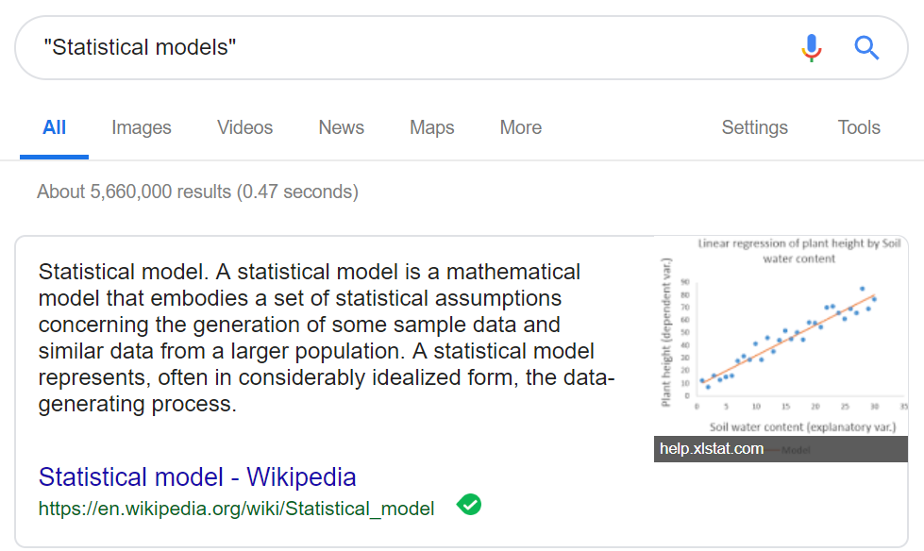

Slide 8
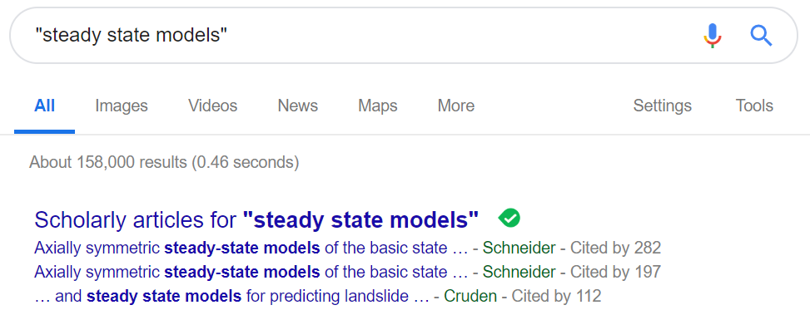

Slide 9
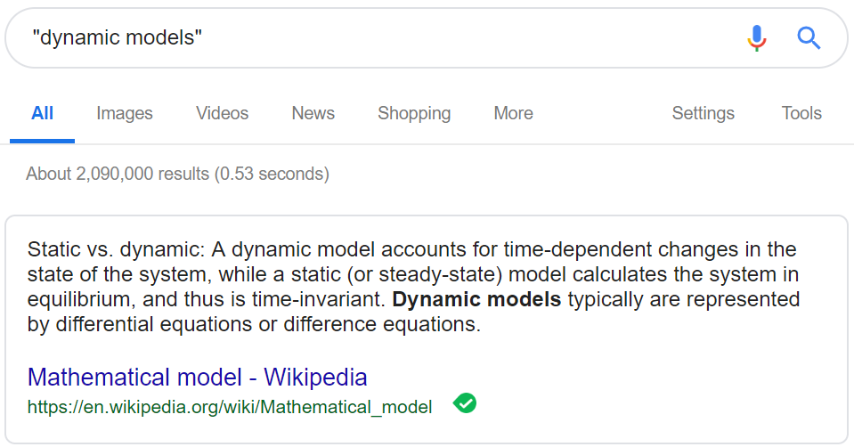

Slide 10
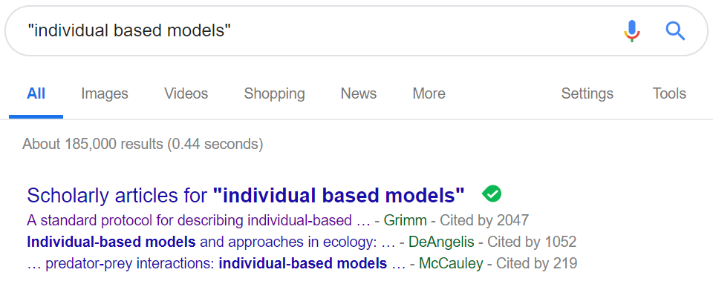
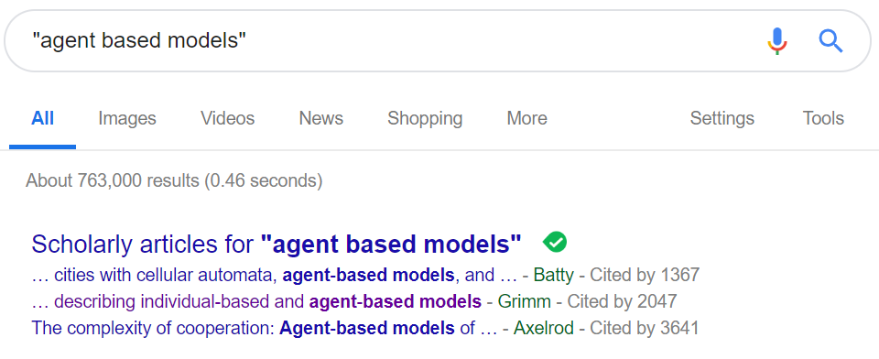

Slide 11
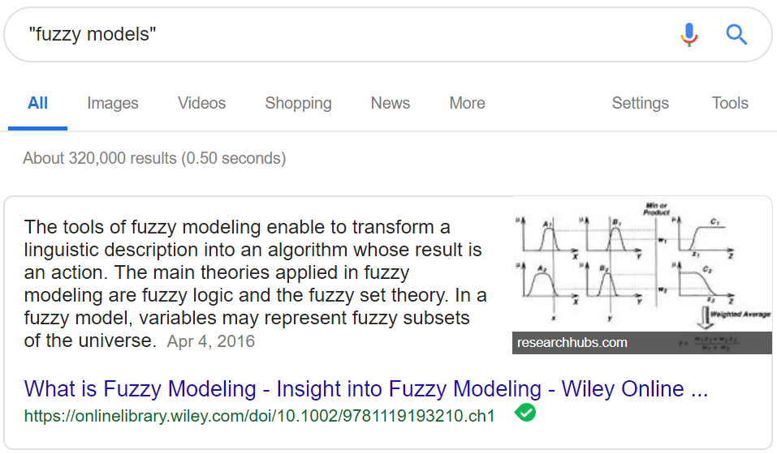

Slide 12
Confusion MATRIX
Sometimes I call A to something you call B
Sometimes we both call A to different things

Slide 13
Modelação ECOLÓGICA: Take home messages
We dealt with:
statistical models
steady state models
dynamic models
individual based models
fuzzy logic models
(and note these boxes are not really completely separable)

Slide 14
Modelação ECOLÓGICA: Take home messages
Statistical models are arguably by far the most widely used, because they are completely general – any dataset is potentially analyzed with statistical models
Steady state models and dynamic models refer to the whether state variables are constant or evolve over time (and while the first type requires gross approximations of most processes, the second requires typically differential calculus which is hard)
Individual based models are excellent for including variability from the individuals, and easy to implement provided one is capable of simulating the system
Fuzzy logic models are great when… things are fuzzy ☺ - and I admit they are growing on me… while I still feel they are just a name with nothing fundamentally different about them. Bayesian methods allow for uncertainty in state assignment in a very similar way, and are statistical models!

Slide 15
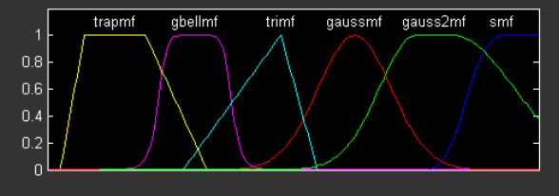
“…A non-specialist user gets the impression that Fuzzy Logic could be re-formed into Bayesian theory with minimal changes in its definitions and axioms…”*
http://www.bel.utcluj.ro/dce/didactic/sln/lab_eng/2MultimiFuzzy_eng/html/FuzzySets.html
* https://www.quora.com/Why-is-Bayesian-approach-more-popular-nowadays-than-Fuzzy-Logic

Slide 16
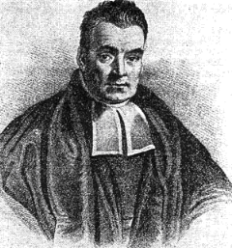
“A FUZZY MODEL IS A BAYESIAN MODEL THAT WAS NOT DEFINED RIGOUROUSLY”
Bayes
Fuzzy Bayes
TAM’s quote on 19/12/2018
TAM’s not quite sure if it is right, but is certainly seems like it!

Slide 17
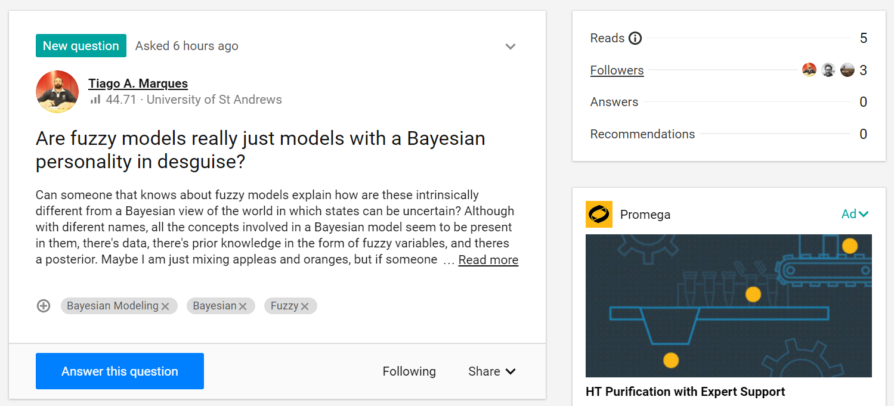
https://www.researchgate.net/post/Are_fuzzy_models_really_just_models_with_a_Bayesian_personality_in_desguise

Slide 18
There are many classes and types of models, and many model classifications possible

Slide 19
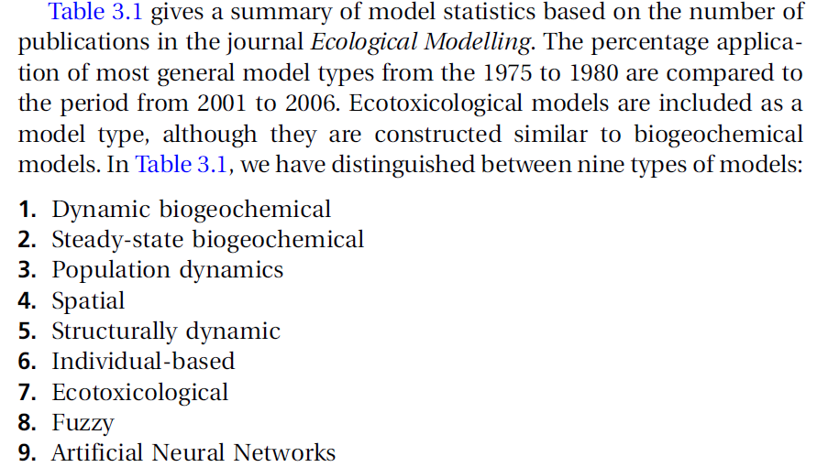
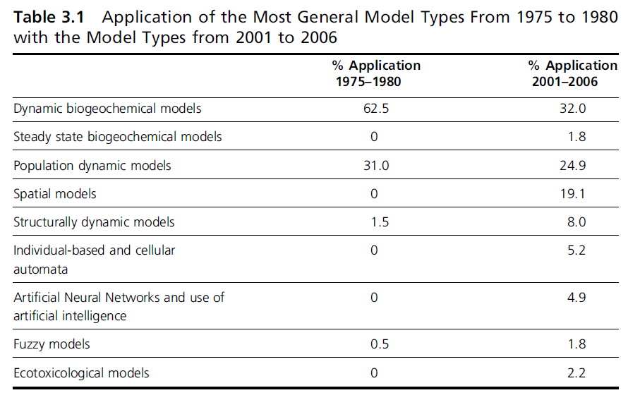
Other types of modelS exist
Jorgensen, S. E. & Fath, B. D. 2011 Fundamentals of Ecological Modelling, Applications in Environmental Management and Research. 4th edition. Elsevier

Slide 20
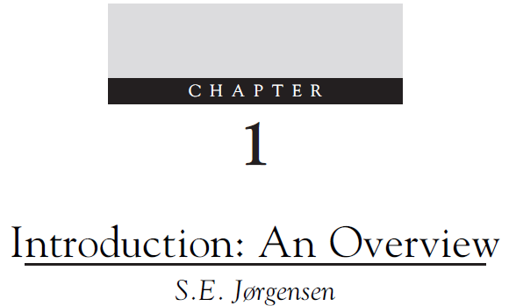
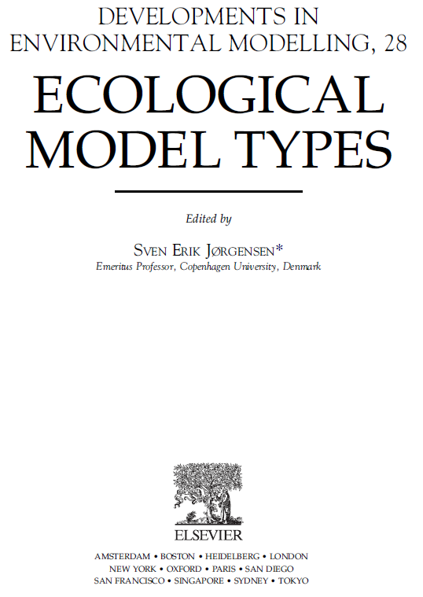
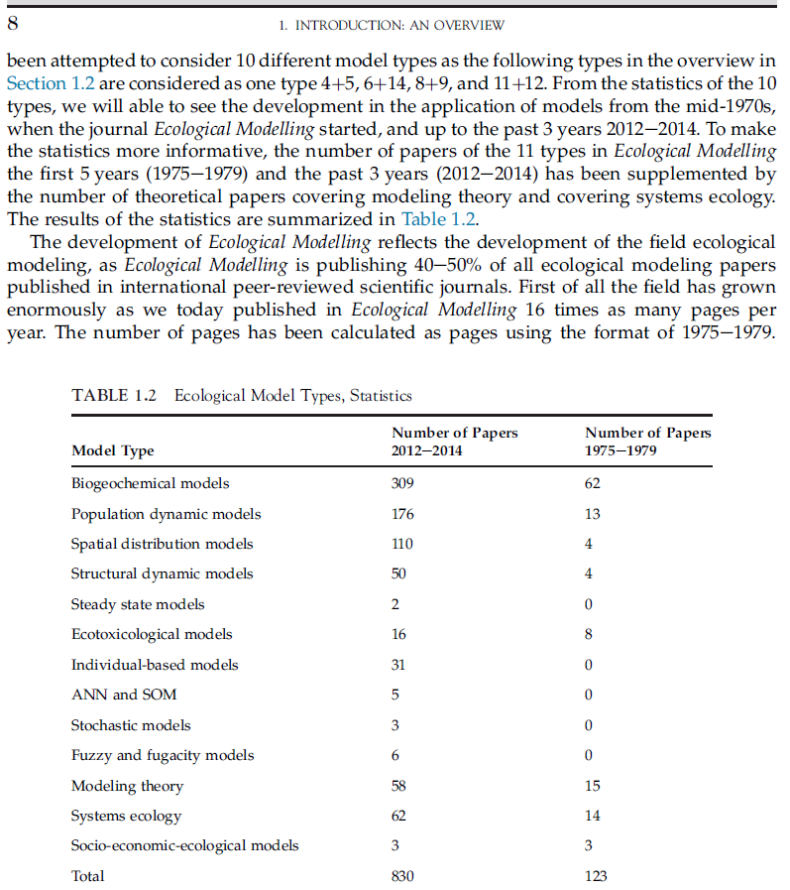
14?
10?
11?
13?
LOL
A very fuzzy number of model types !!!
1
2
3
4
5
6
7
8
9
10
11
12
13

Slide 21
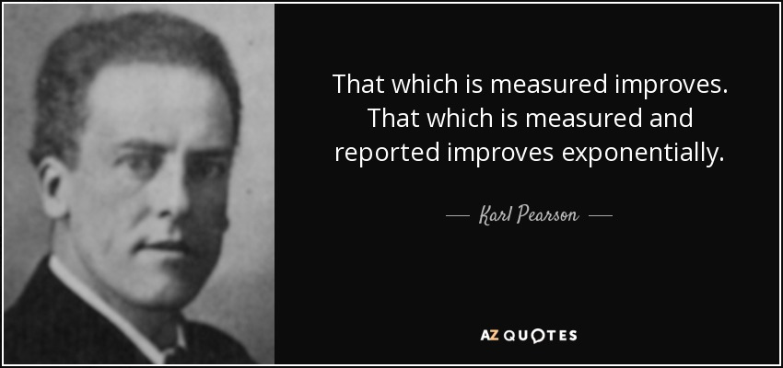
Modelação ECOLÓGICA: Take home messages
Modern Biology and Ecology do not exist with quantification
https://www.azquotes.com/quote/727622

Slide 22
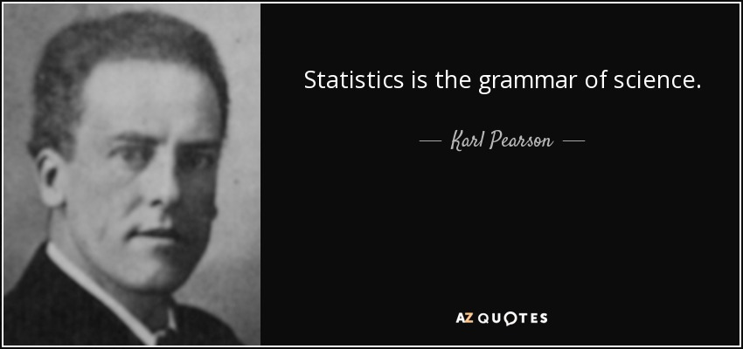
Modelação ECOLÓGICA: Take home messages
If you quantify you have to analyze
If you analyze you have to know statistics
https://www.azquotes.com/author/23606-Karl_Pearson

Slide 23
Modelação ECOLÓGICA: Take home messages
You don’t need to be a statistician
What you have over a statistician is the ecological and biological insight
You need multidisciplinary teams to solve problems together!

Slide 24
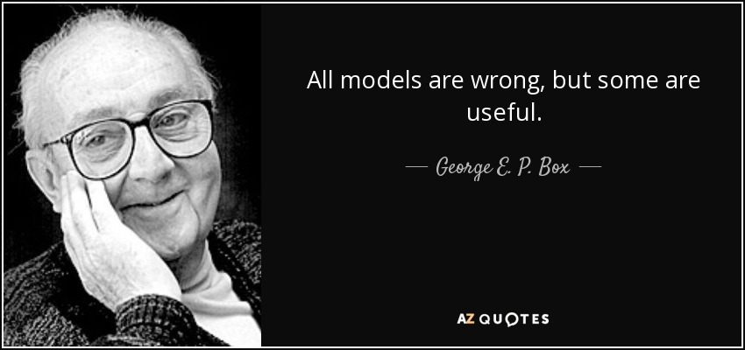
https://www.azquotes.com/author/22390-George_E_P_Box

Slide 25
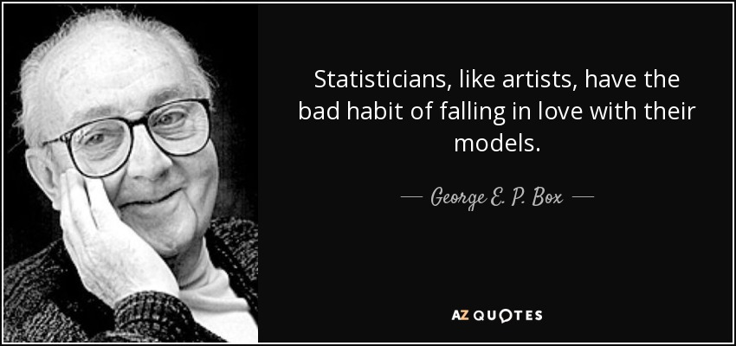
https://www.azquotes.com/quote/603404

Slide 26
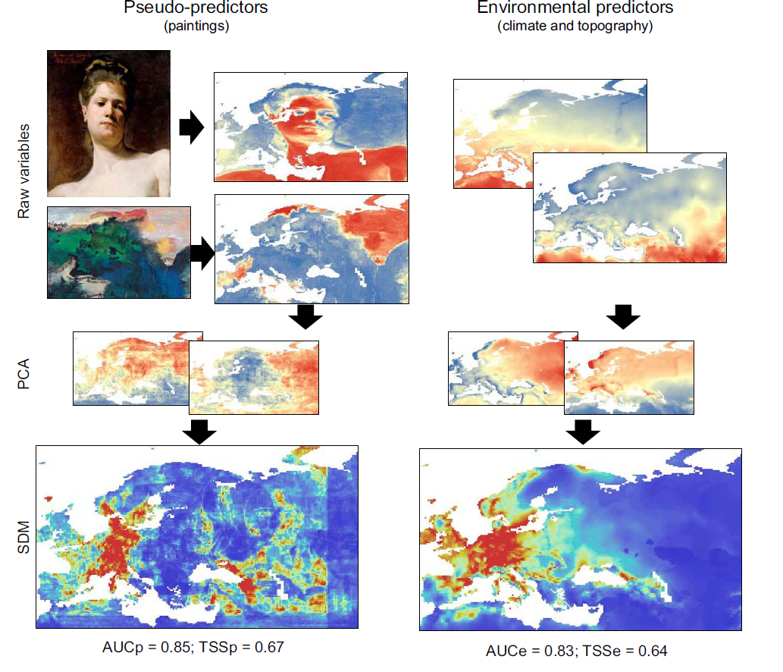
Fourcade, Y.; Besnard, A. G. & Secondi, J. 2017 Paintings predict the distribution of species, or the challenge of selecting environmental predictors and evaluation statistics Global Ecology and Biogeography 27: 245-256

Slide 27
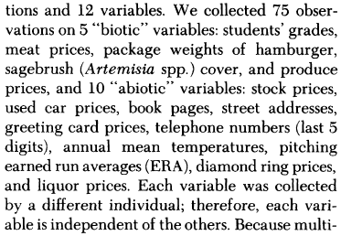
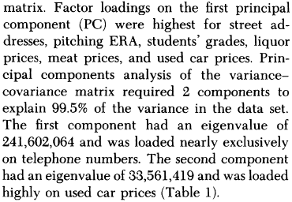
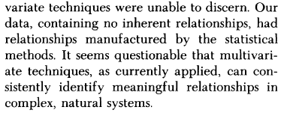
Rexstad, E. A.; Miller, D. D.; Flather, C. H.; Anderson, E. M.; Hupp, J. W. & Anderson, D. R. 1988 Questionable multivariate statistical inference in wildlife habitat and community studies The Journal of Wildlife Management 52: 794-798

Slide 28
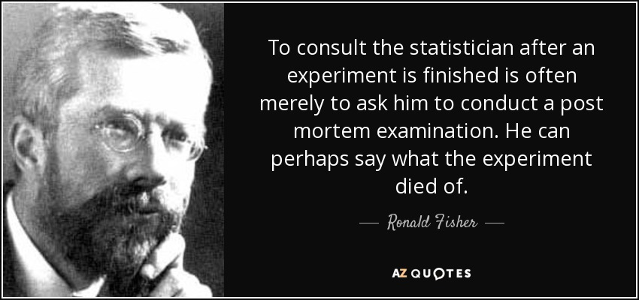
The only thing that can save you from fear is common sense, turning the brain on (even) before starting data collection!
https://www.azquotes.com/quote/97013

Slide 29
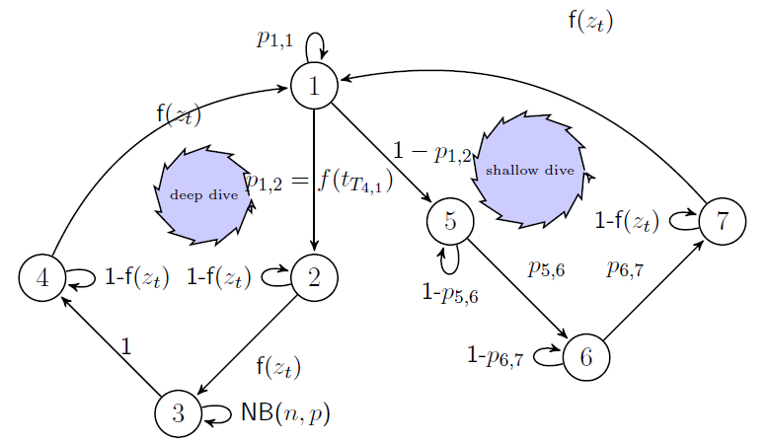
Como CONCEPTUALIZAR A REALIDADE

Slide 30
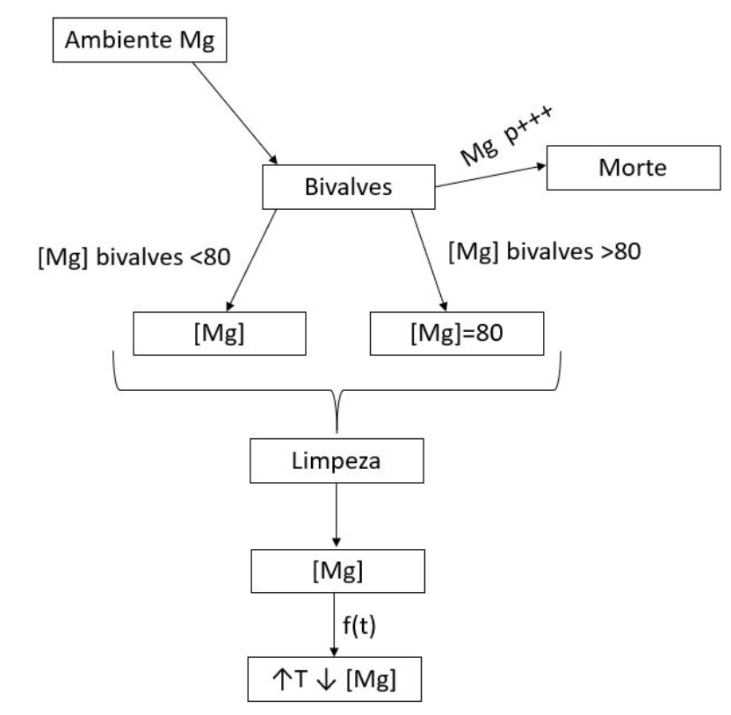
Como CONCEPTUALIZAR A REALIDADE
© Joana Araujo

Slide 31
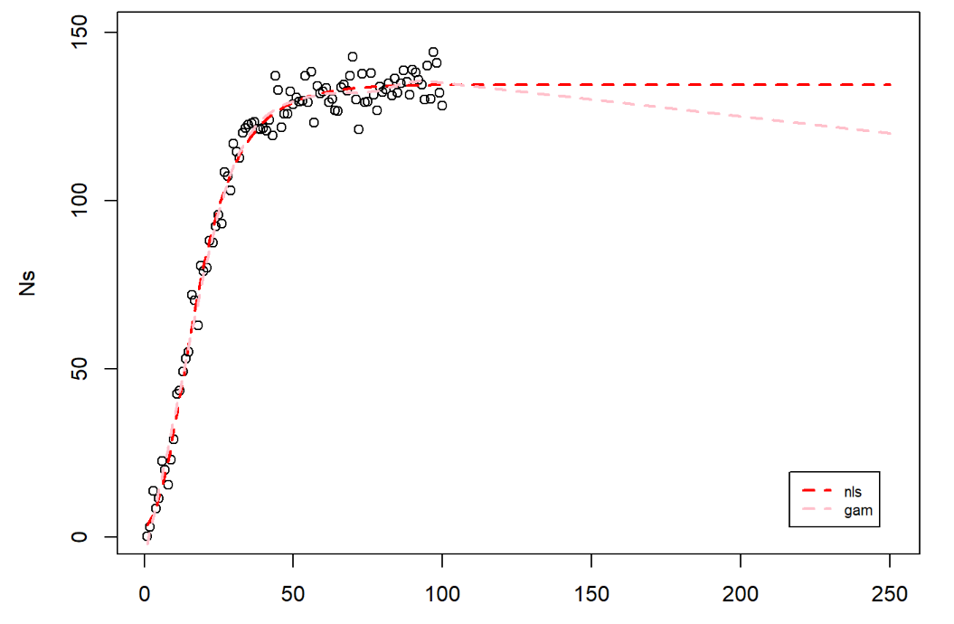
Be careful with extrapolations!
A pure statistical model (gam) versus a mechanistic model (one that describes the phenomena in a meaningful interpretable way)

Slide 32
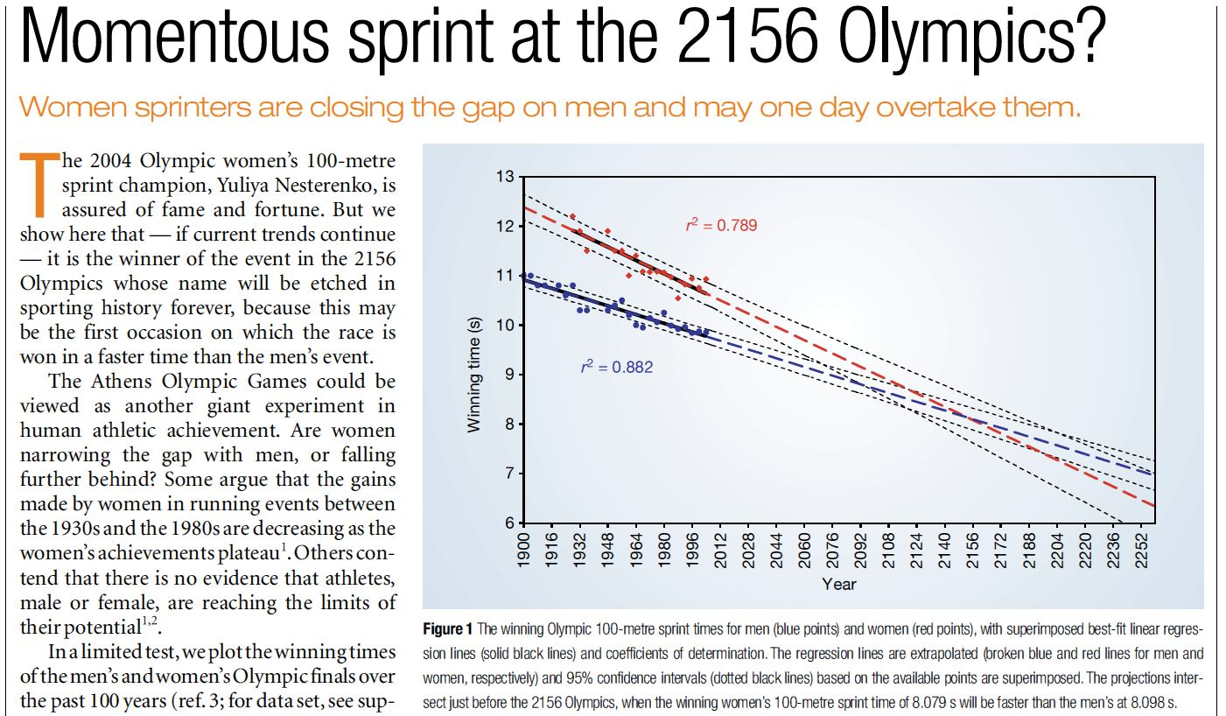
Perigos da extrapolação
Tatem, A. J.; Guerra, C. A.; Atkinson, P. M. & Hay, S. I. 2004 Momentous sprint at the 2156 Olympics? Nature 431: 525-525

Slide 33
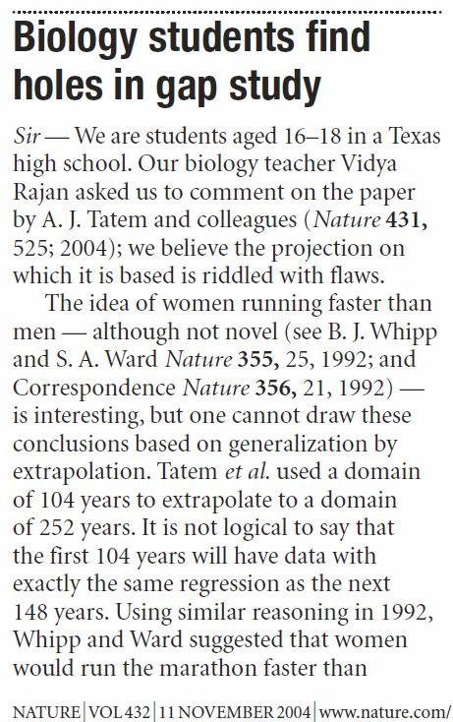
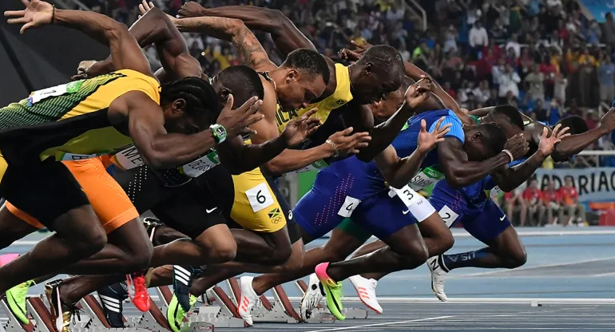
Perigos da extrapolação

Slide 34
O que quero que saibam (ou gostaria que soubessem!) fazer no final deste curso
É sempre bom voltar ao ponto de partida… (slides da aula 1)
Não ter medo de modelos
Saber aproximar uma realidade complexa por um modelo simplificado
Conhecer uma variedade de modelos aplicáveis a dados ecológicos
Obter estimativas dos seu parâmetros com base em dados reais
Simular sistemas ecológicos através de modelos
Trabalhar de forma independente sobre dados ecológicos e implementar relatórios dinâmicos em RMarkdown

Slide 35
“Mention ecological modelling and many people run screaming in horror” *
But not you, not anymore! (hopefully)
* in “Ecological models – their form and function _ Kararehe Kino Issue 17 _ Manaaki Whenua - Landcare Research.pdf” –FENIX Aula 1

Slide 36
Objectivo (adicional): vir a publicar aqui: ☺

Slide 37
My recommendation is that you are model “type” agnostic – you don’t believe or trust in any model in particular, you use the ones that are useful to you at any one time!
Irrespectively of the model type, you always pay close attention to parameter estimation (or model calibration), check the model assumptions and evaluate the sensitivity of its performance to their failure
Fitting some of these models might be a task for a PhD, even a life time. So don’t despair easily!

Slide 38
PERHAPS THIS IS NOT WHAT YOU WANT TO HEAR BUT…
Much of the work published is not necessarily good work
Many models out there are not necessarily good models
Always use critical thinking
Modelling is as much of an art as of a science!

Slide 39
Next steps
Prepare presentation report (31st December)
Prepare final practical work (21st January)
Prepare abstracts (21st January)
Prepare “Ecological Modelling” day (ongoing even after 21st January)
Different activities can be prepared
Think about people to invite for talks (one per type of model?)
Format of the day
Prepare website? Facebook page? Twitter account? Hastags? Create google group?
Articulate with different “ramos”
Articulate with DBA and DBV

Slide 40
Next steps
Write a paper (ongoing even after 21st January)
Write methods
Write what you have learned with the experience
Data repository for predator & prey data
Shinny app for predator & prey data
R package for predator & prey data
Contribute with your own ideas (some have already started that process!)
Be pro-active. I am on e-mail and available for meetings continuously until the 21st of January (and after that of course for any ongoing work)!

